Slide 1


Slide 2
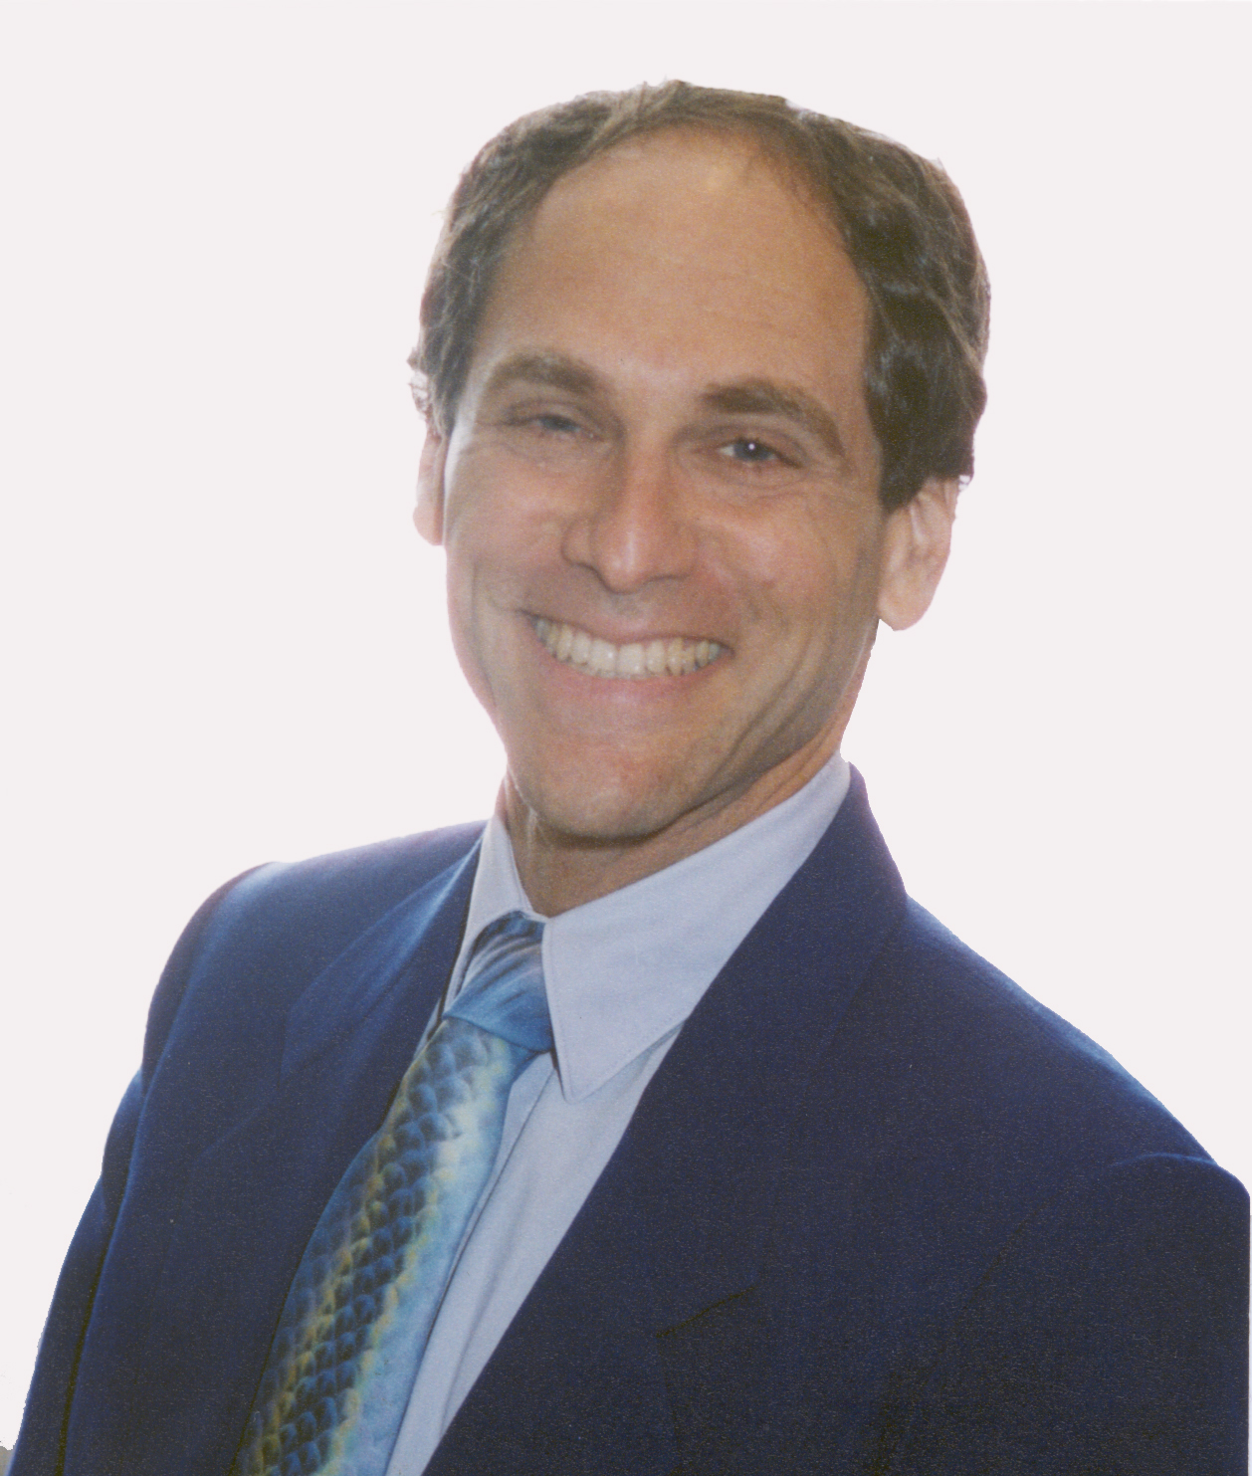

Slide 3
HOW TO BECOME ENERGY EFFICIENT IN YOUR MIND, BODY & SPIRIT
Terry Braverman

Slide 4
ENERGY ENHANCERS
1. Reconnecting to Purpose
2. Deep Breathing
3. Communing with Nature
4. Food Supplementation
5. Creating Rapport with Others

Slide 5
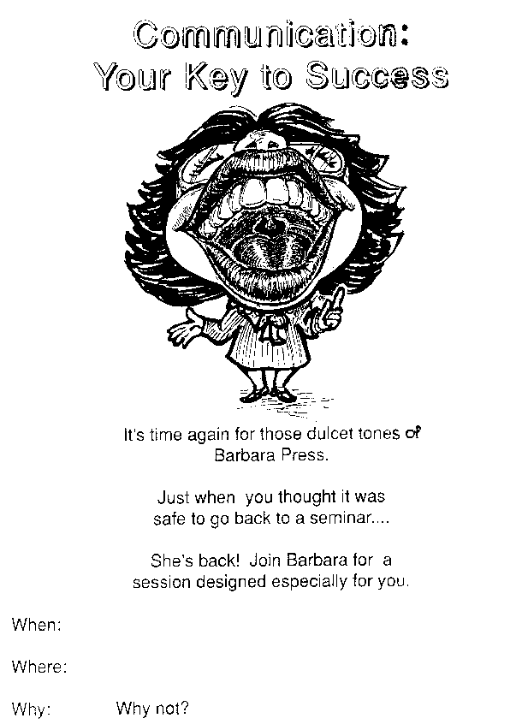

Slide 6
THE FOUR PERSONALITY TYPES
1. Dominator
2. Entertainer
3. Analytic
4. Relater

Slide 7
MY ORIGINAL QUOTES
An ounce of pretension is worth a pound of manure
Laugh at yourself, and you will always be amused
Be patient, before you become a patient
A closed mouth gathers no feet
May the 'farce' be with you

